Slide 1

Rotary Club of Nyack, NY

Slide 2
The Purpose of this Rotary Orientation meeting is…….
To give you – a new member – a summary of Rotary and the service projects our Club engages in throughout the year.
To let you know what you may expect of your membership.
To let you know what our club will expect of you as a member.
To answer any questions you may have about Rotary in general and Rotary Club of Nyack in particular.

Slide 3
Rotary in an International Organization
Rotary International is divided into territories which are known throughout the free world as Rotary Districts.
There are over 500 districts in the Rotary World – in 168 countries, 34,558 clubs and over 1.2 million Rotarians.
Our Club is in District 7210 : 56 Clubs and a total membership of over approximately 1,550 Rotarians.
Rotary International is governed by a President and Board of Directors. Rotary Districts elect a new District Governor every year. Each Club has its own President, Board of Officers and Directors.

Slide 4
Paul P. Harris Legacy
Paul P. Harris was an attorney who organized the first Rotary Club in Chicago in 1905. This club met in rotation at the offices of the members – thus the name Rotary.
There are now more than 35,000 Rotary Clubs with a total Rotary membership of more than 1.2 million.

Slide 5
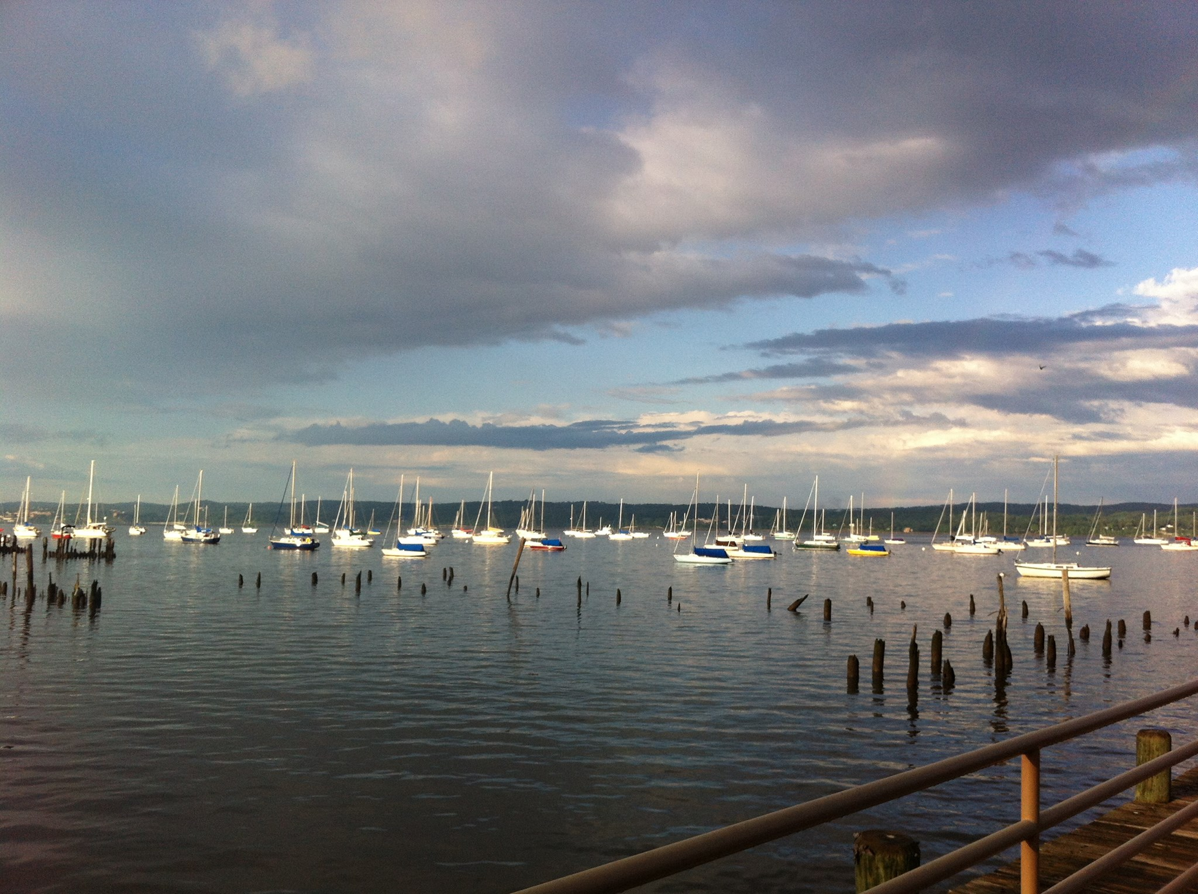
Nyack is….
A Rivertown outside of New York City along the Hudson River
Approximately 13,000 residents
1 High School
1 Middle School
3 Elementary Schools

Slide 6
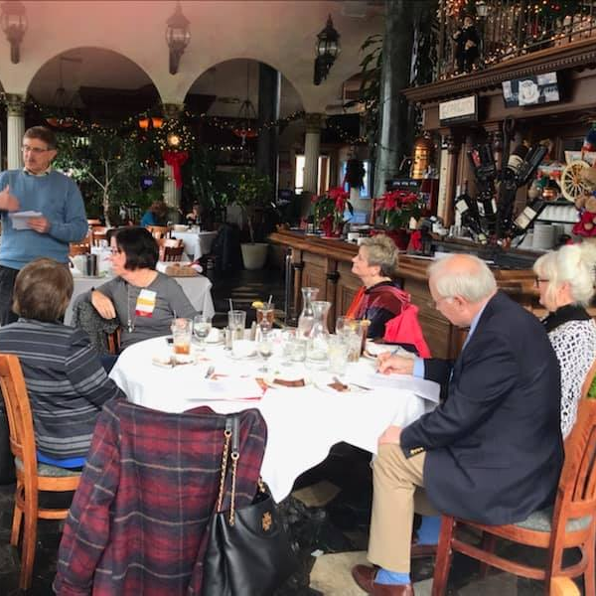
Who are we?
32 Active members
11 Honorary Members
1 International Honorary Member:
Suen Broyles
One of 10 Rotary Clubs in Rockland County
One of 56 Rotary Clubs in District 7210

Slide 7
The Four Way Test of the things we think, say and do in Rotary!
1) Is it the TRUTH?
2) Is it FAIR to all concerned?
3) Will it build GOODWILL and BETTER FRIENDSHIPS?
4) Will it be BENEFICIAL to all concerned?

Slide 8
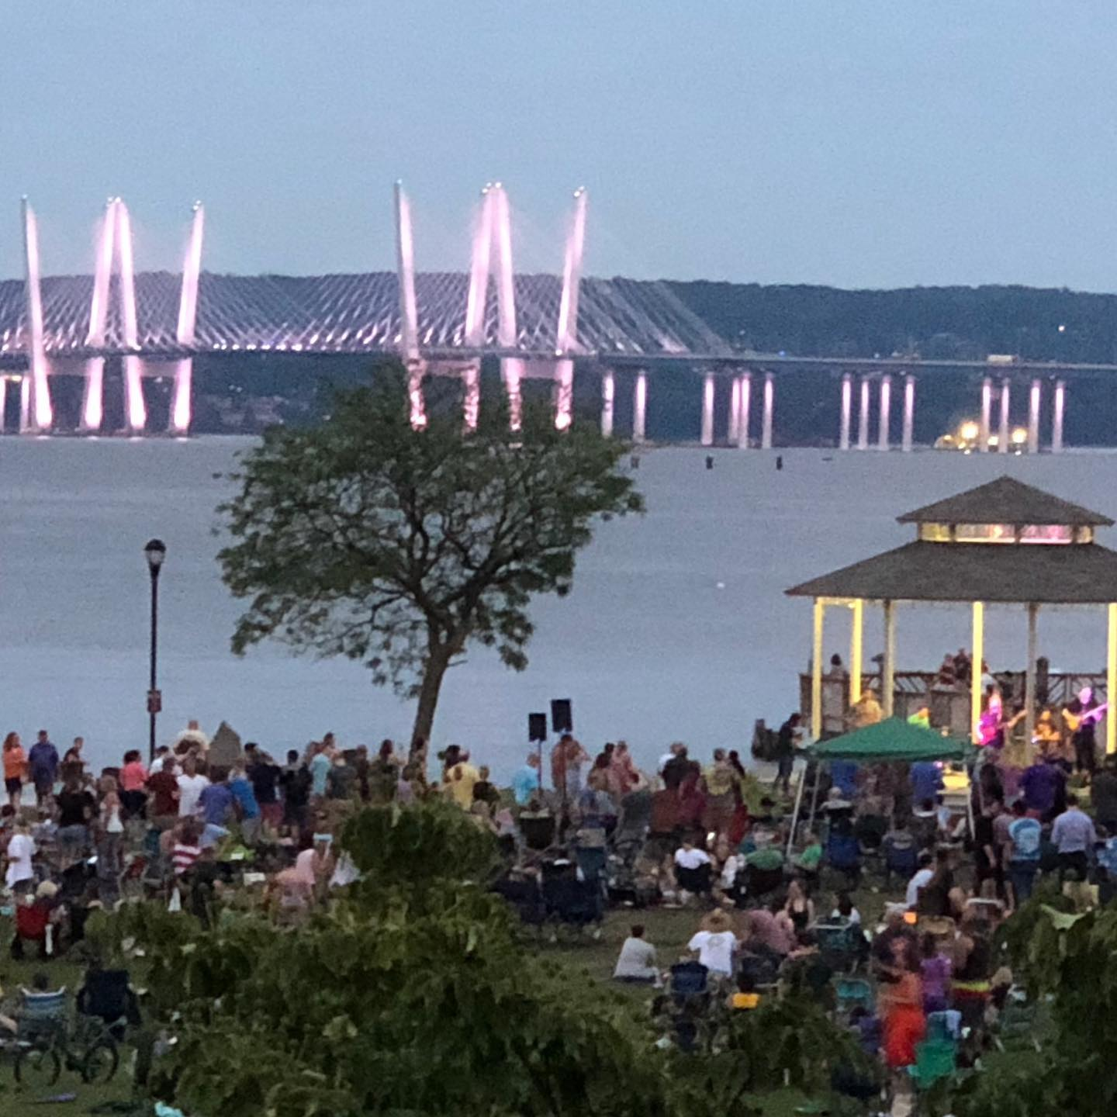
Rotary Club of Nyack
Rotary Club of Nyack began in 1923 and was the first Rotary Club in Rockland County.
In 2023 we celebrate our 100 year anniversary.
Our signature program is our “Cover to Cover” (Preschool to High School) Education Program.

Slide 9
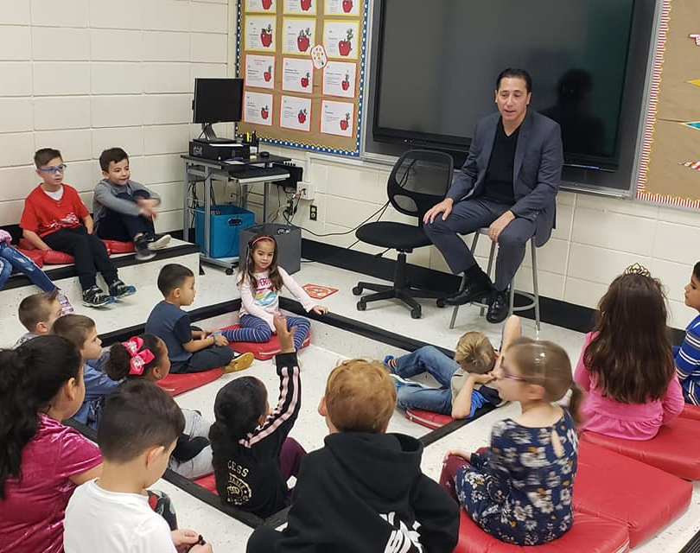
Cover to Cover
Education Program
Rotarians read to all first graders in Nyack School District .
Each student is given a book to take home with a Rotary sticker on it.

Slide 10
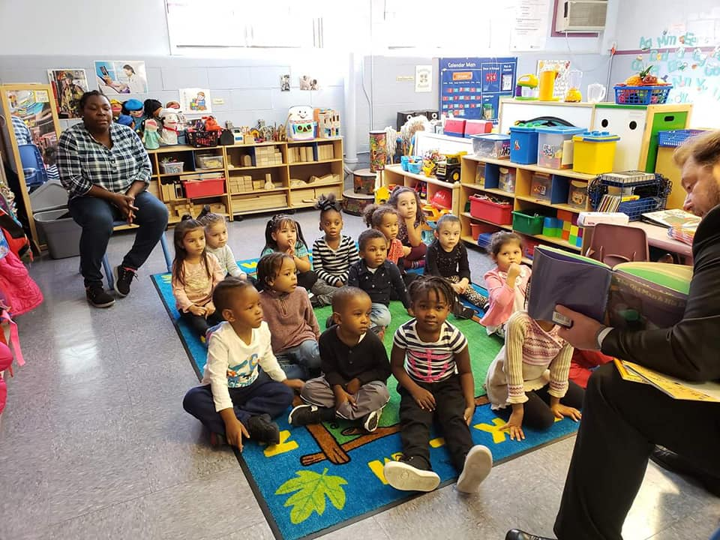
Cover to Cover
Literacy
Rotarians read to Preschool students at Headstart.
Each preschooler is given a book to take home.

Slide 11
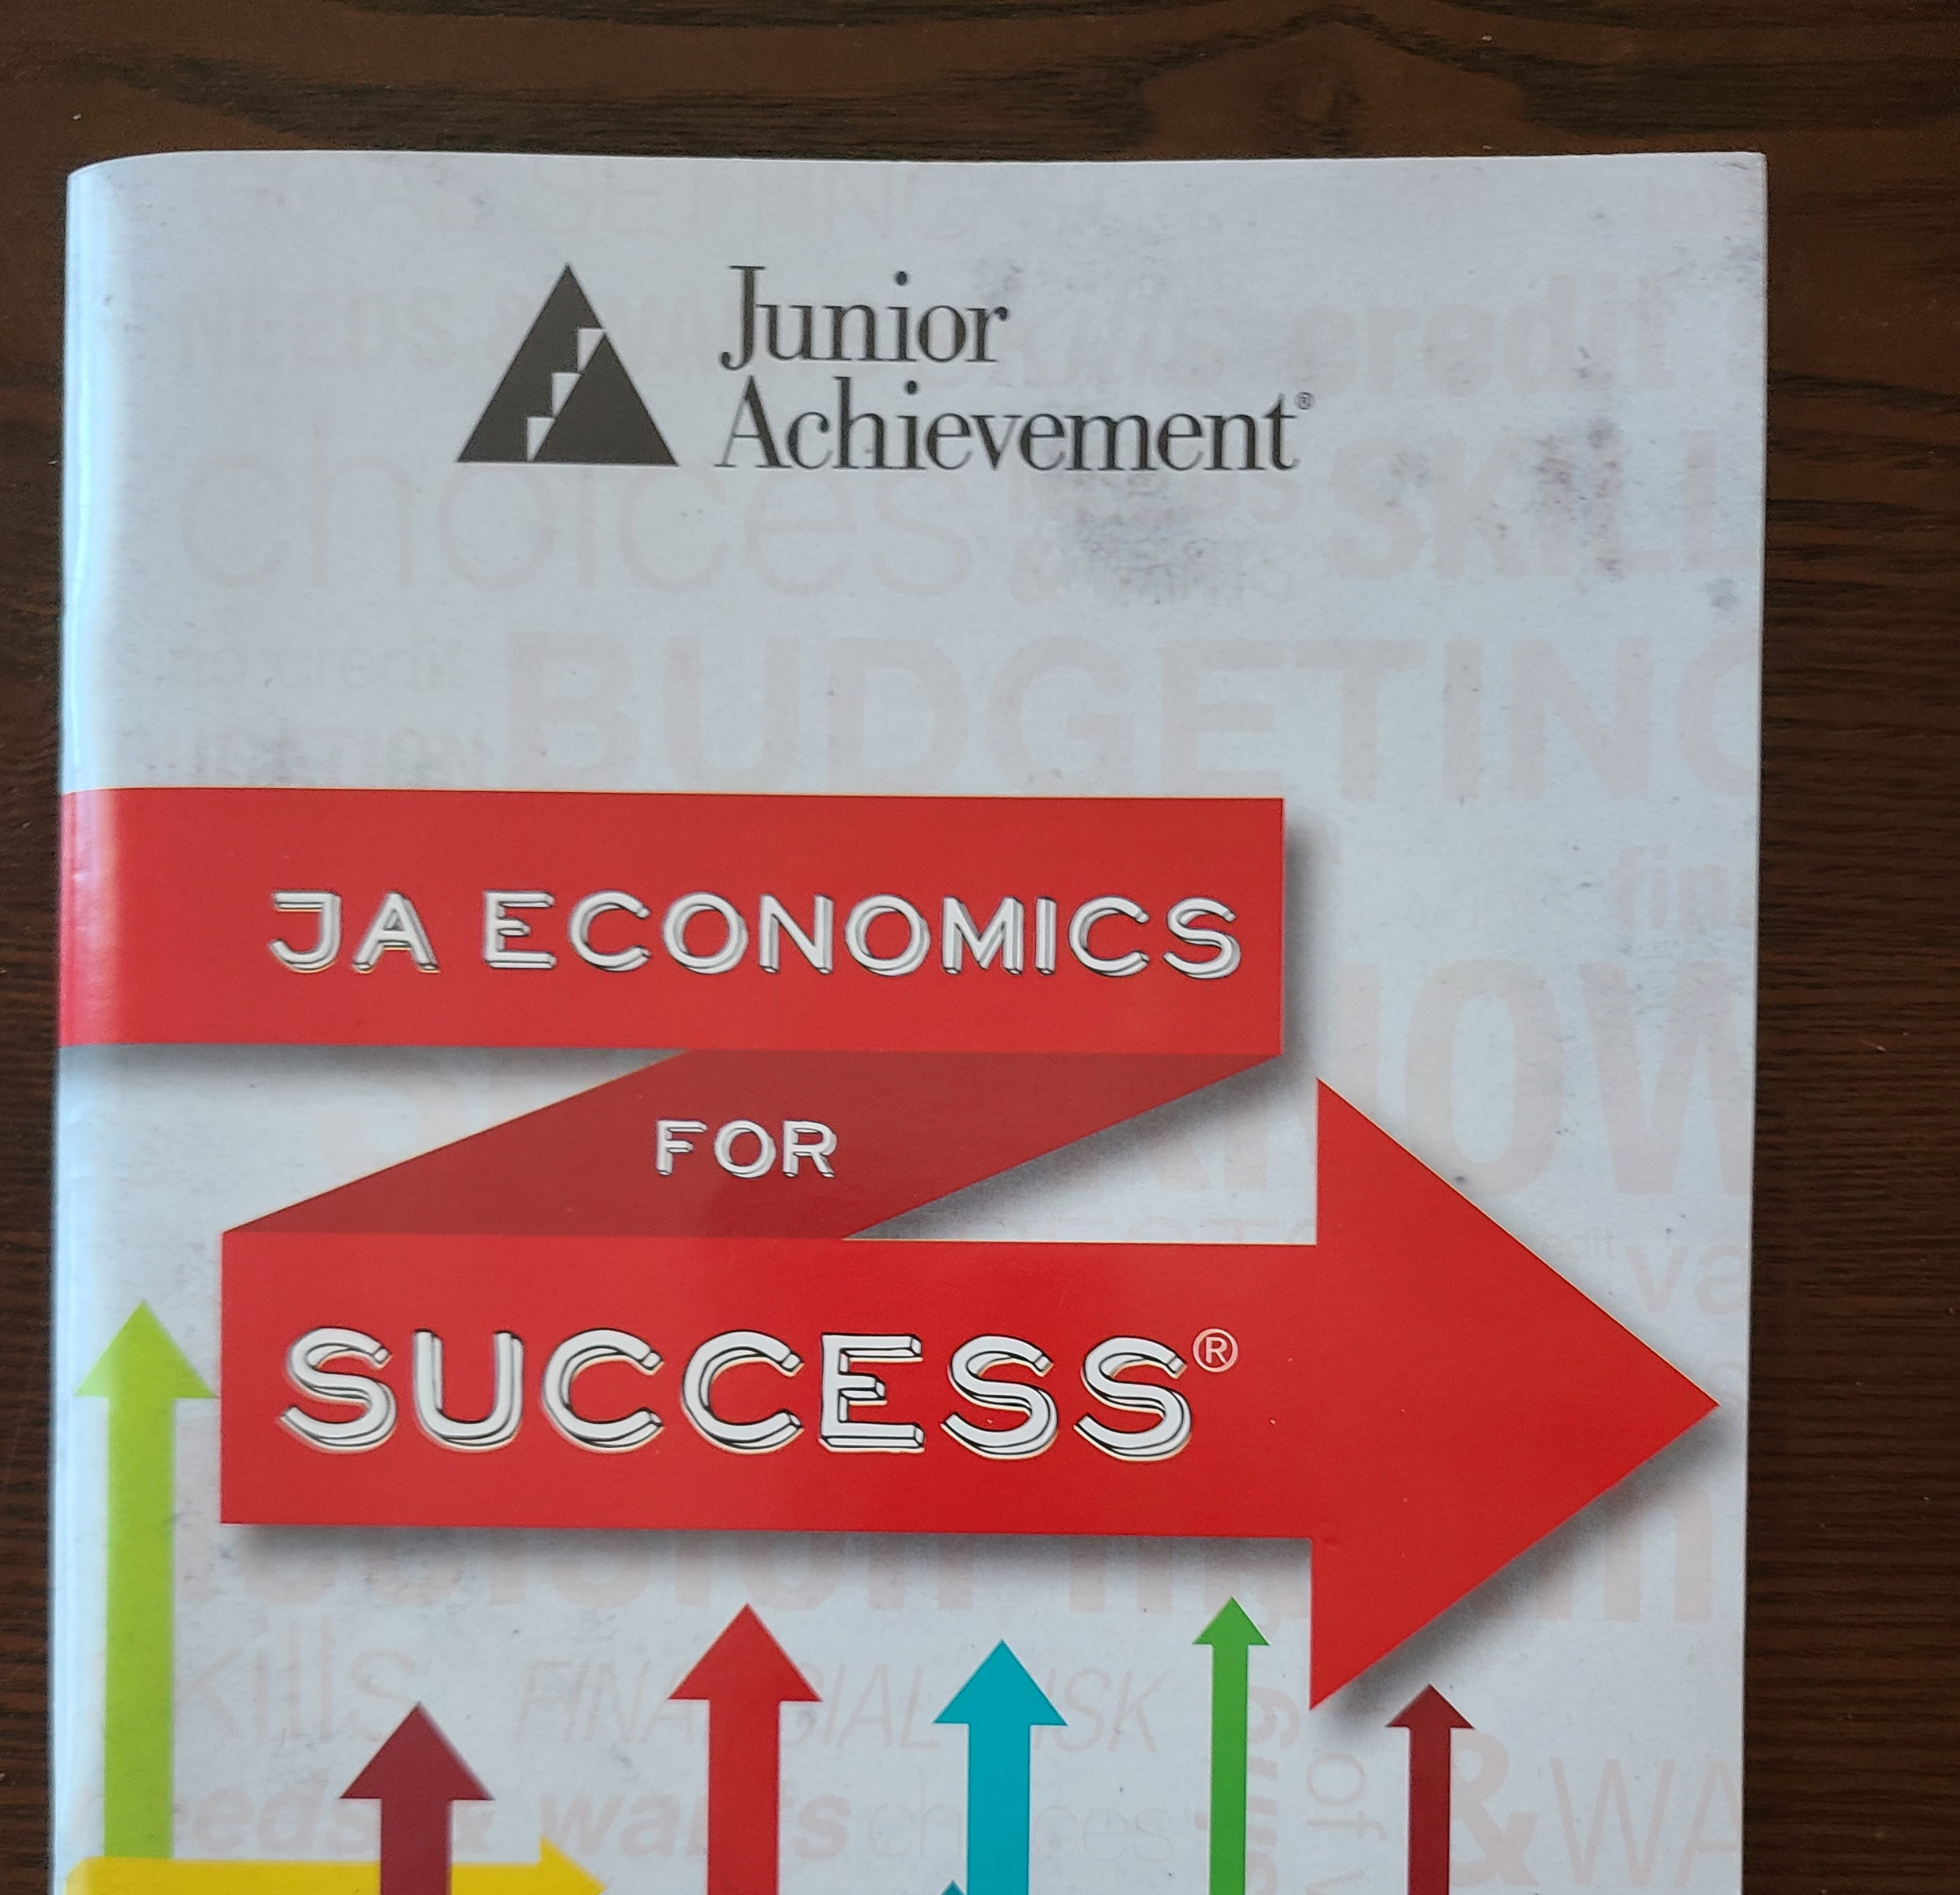
Cover to Cover
Junior Achievement
6 week class on work force readiness and financial literacy
Taught to all 7th graders by Rotarians

Slide 12
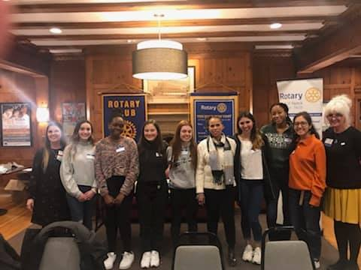
Cover to Cover
Interact
Interact student Officers were officially installed at a Rotary evening meeting.
Nyack High Schools Interact Club has approximately 22 members.
Rotarians partner with Interact on Service Projects.

Slide 13
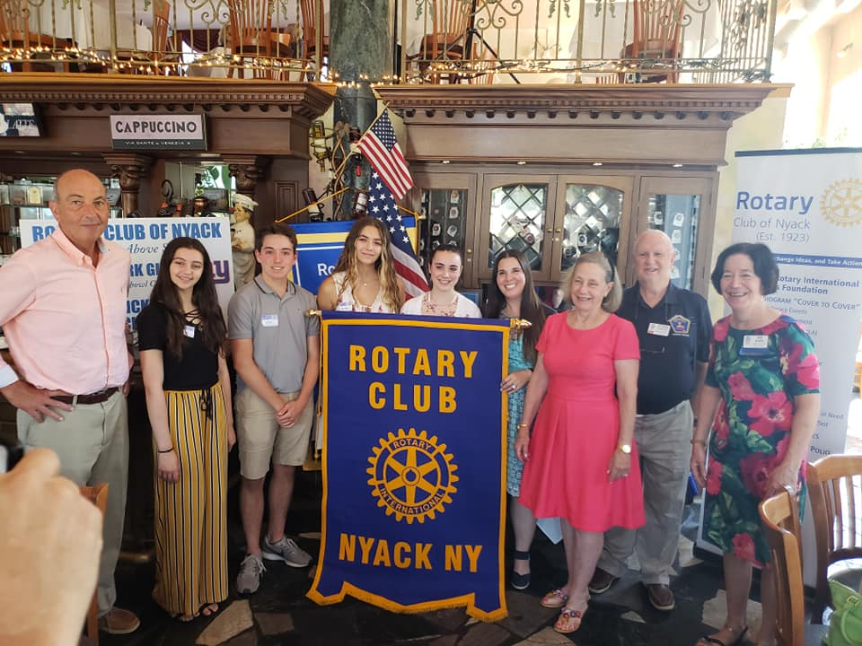
Cover to Cover
RYLA
Rotary Youth Leadership Awards (RYLA) scholarships are provided to approximately 3-5 High School Sophomores.

Slide 14
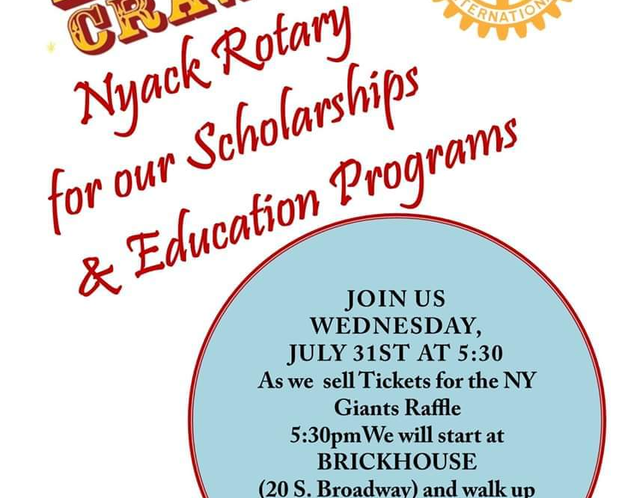
Cover to Cover
Scholarships
Rotary Club of Nyack awards 6 High School graduates with $1000 scholarships.
Criteria for Scholarships include academics as well as community service.

Slide 15
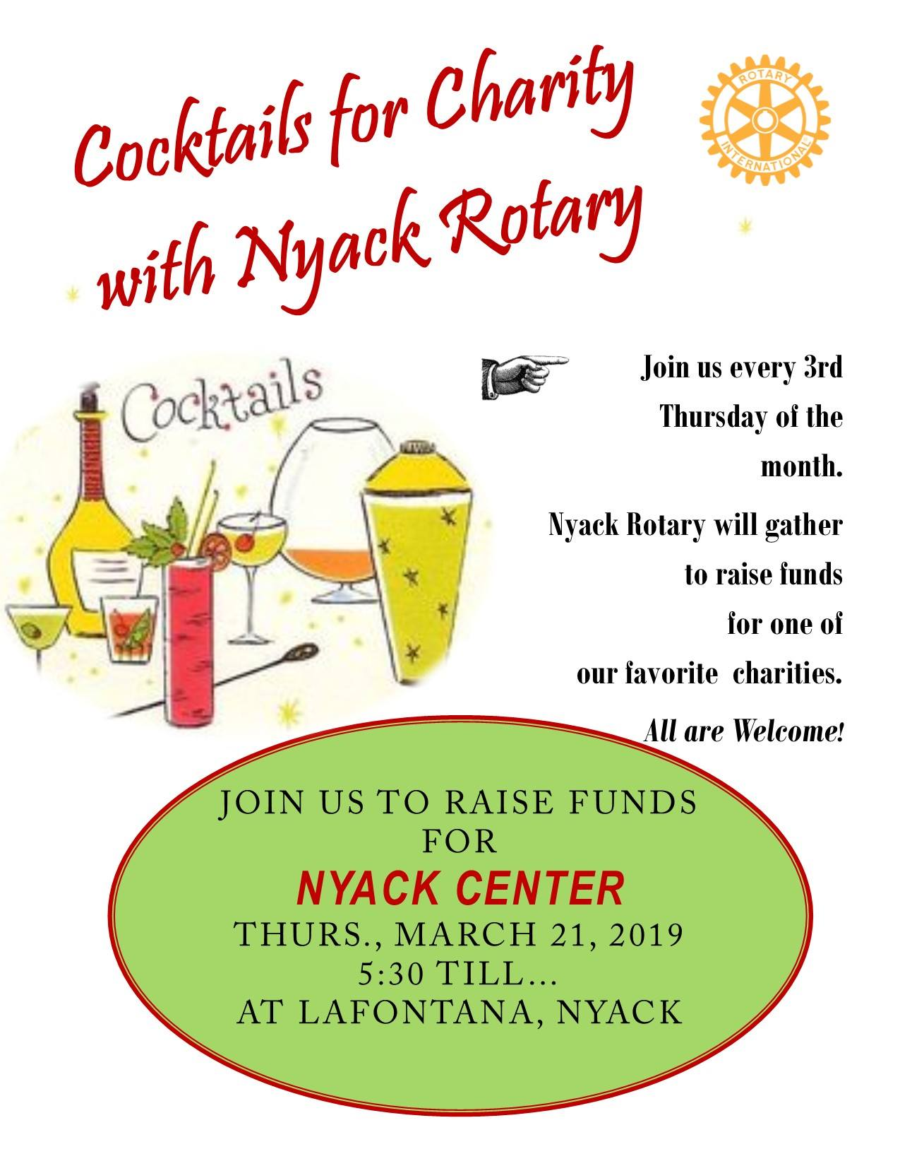
Cocktails for Charity
The third Thursday of each month we host a Cocktails for Charity to raise funds for one of our favorite charities with 50/50 and wine raffles.
Charities have included:
  Meals on Wheels
  People to People
  Nyack Center
  YMCA
  Nyack Basics
  Montefiore Nyack Hospital
  Rockland Pride
  Nyack Library

Slide 16
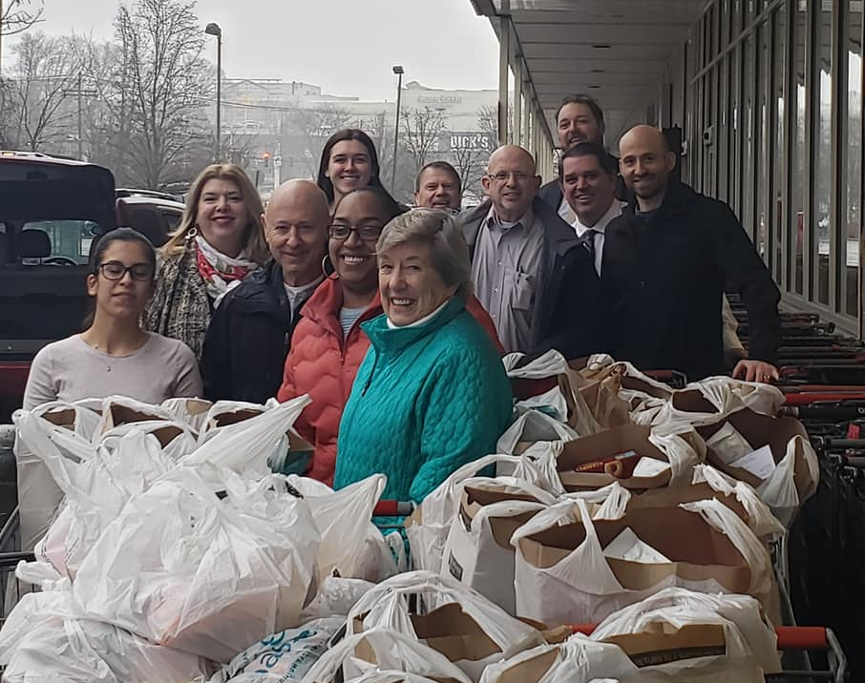
Valentine Bags of Food Deliveries
Rotarians fund and deliver two bags of food, one perishable and one not, to over 70 families identified by those in most need within the school district.

Slide 17
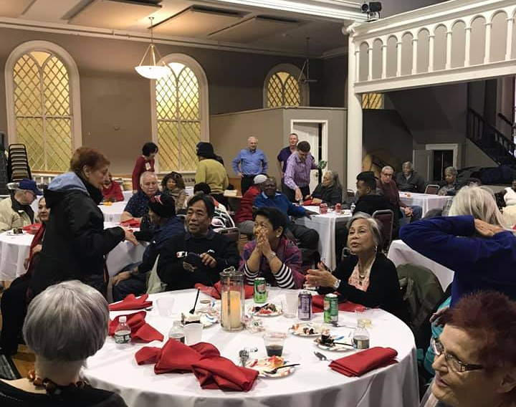
Senior Holiday Luncheon
A catered luncheon is provided to approximately 90 Senior Citizens.
Rotarians provide friendly conversation, music, a Christmas sing-a-long and a visit from Santa Claus who hands out $20 gift certificates to a local food store.

Slide 18
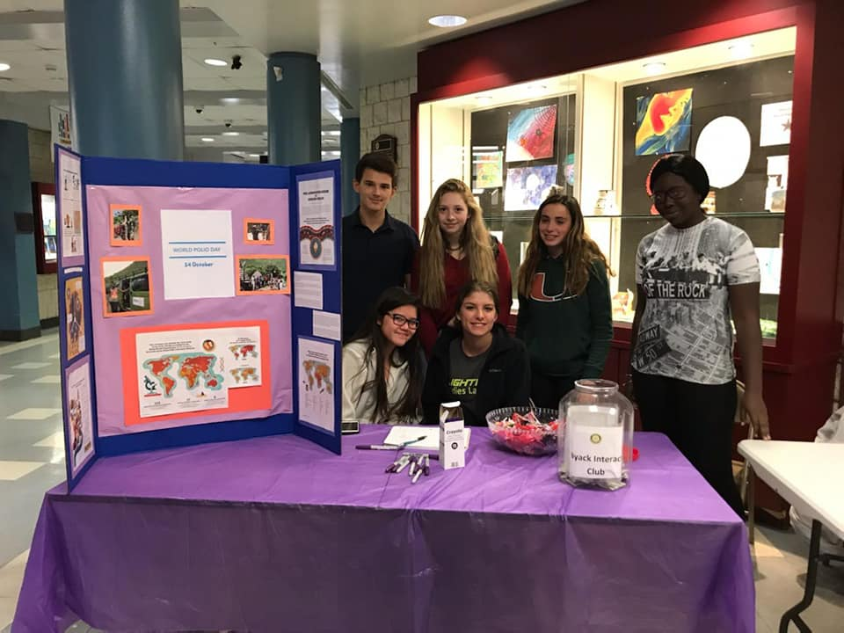
Interact Polio Drive
Interact students held a Purple Pinkie Day to raise awareness and money for Polio on World Polio Day.

Slide 19
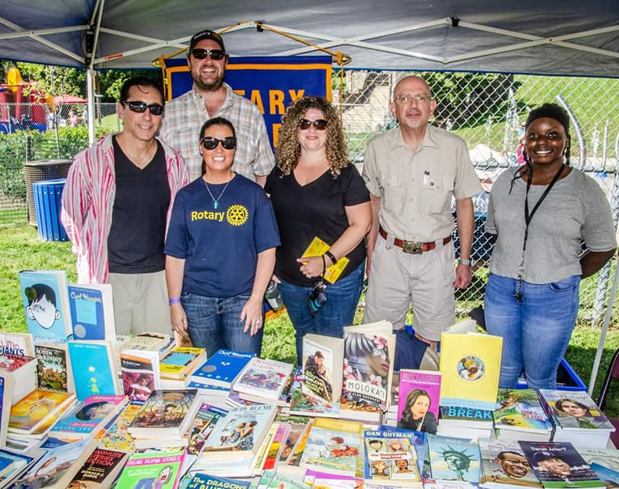
Great Nyack Get Together
A Free yearly Community gathering at Memorial Park along the Hudson River highlighting non-profits and resources in the district for families to access.
Rotary Club of Nyack has a booth at this community fair.
Rotarians give out free books and Interact students read to young children.

Slide 20
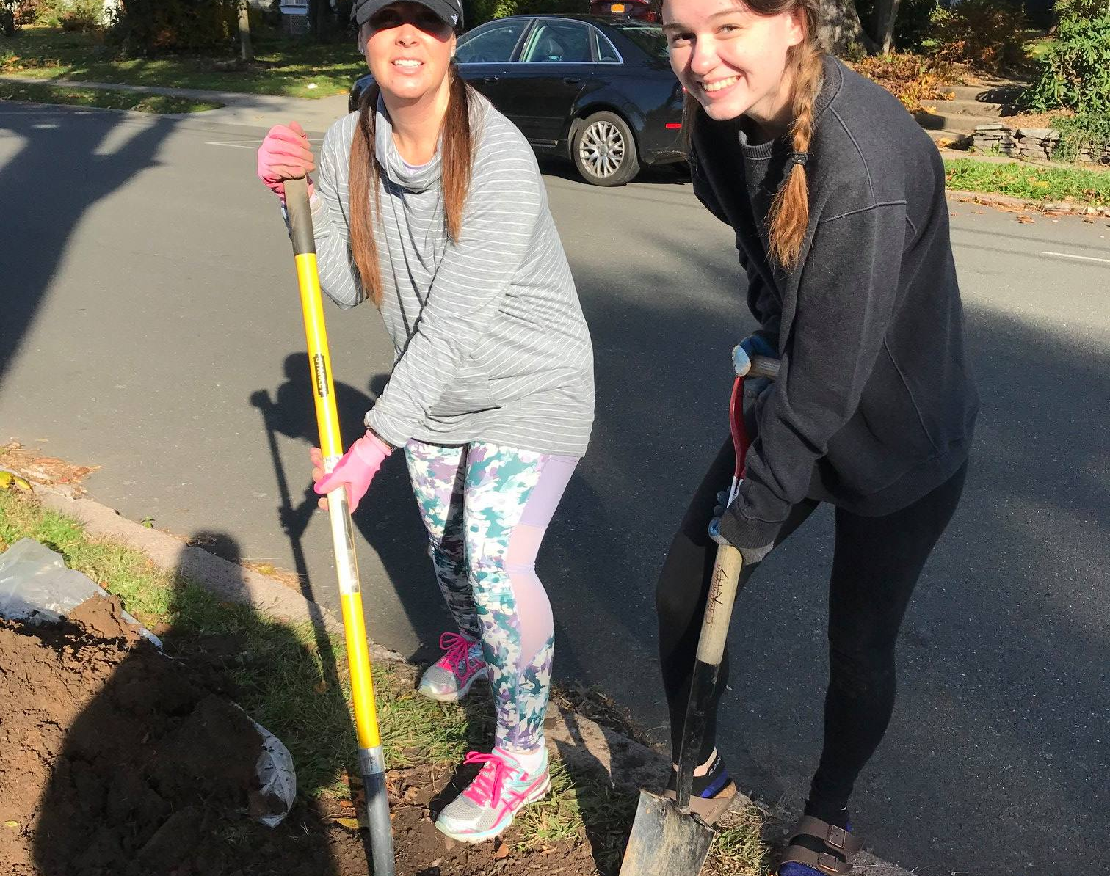
Tree Planting Project
Rotarians and Interact students plant trees yearly for Nyack Tree Community project.

Slide 21

Rotarians
Rally for Restaurants
During the pandemic, and in support of our community, Rotary Club of Nyack promoted ordering food from our local restaurants that were available for take out.
We promoted a different restaurant each week and used Social Media to get the word out to other Rotarians and friends.
Restaurants felt the support from our efforts.

Slide 22
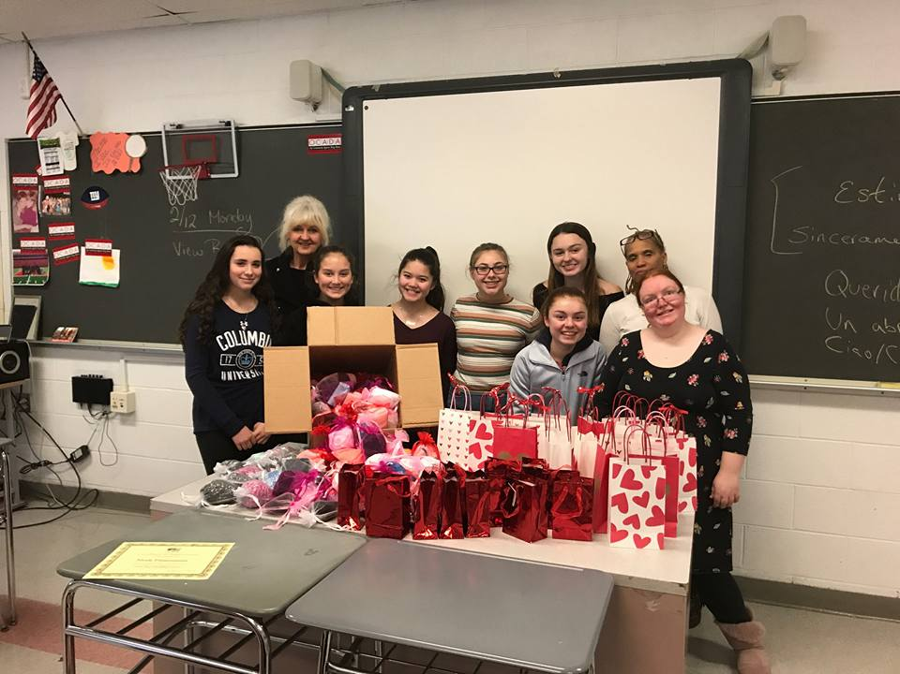
Interact & Rotary “Socks for Others” Project
Every February, the Interact Club students host a Socks for Others project.
Last year 12 Rotarians joined 12 Interact students and gift packaged over 1000 pairs of socks.
Socks were given to United Way to be distributed to the those in most need.

Slide 23
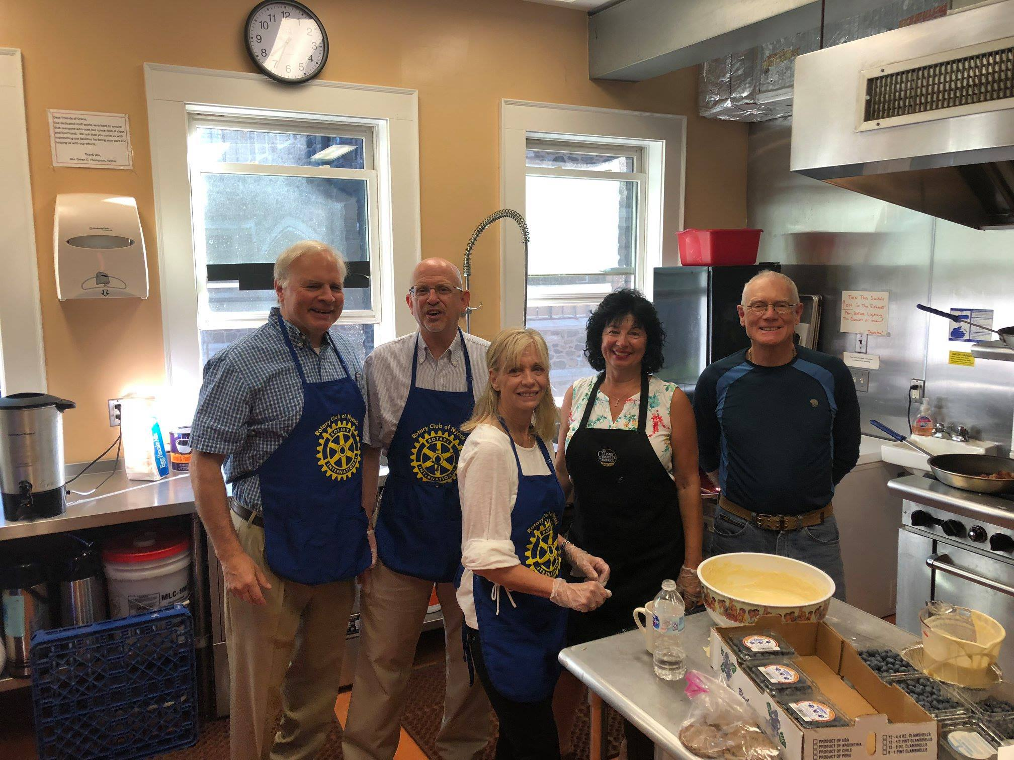
Grace’s
Kitchen
A team of 5-8 Rotarians cook and serve breakfast to homeless and those in need at Grace’s Episcopal Church in a rotation with other organizations.

Slide 24
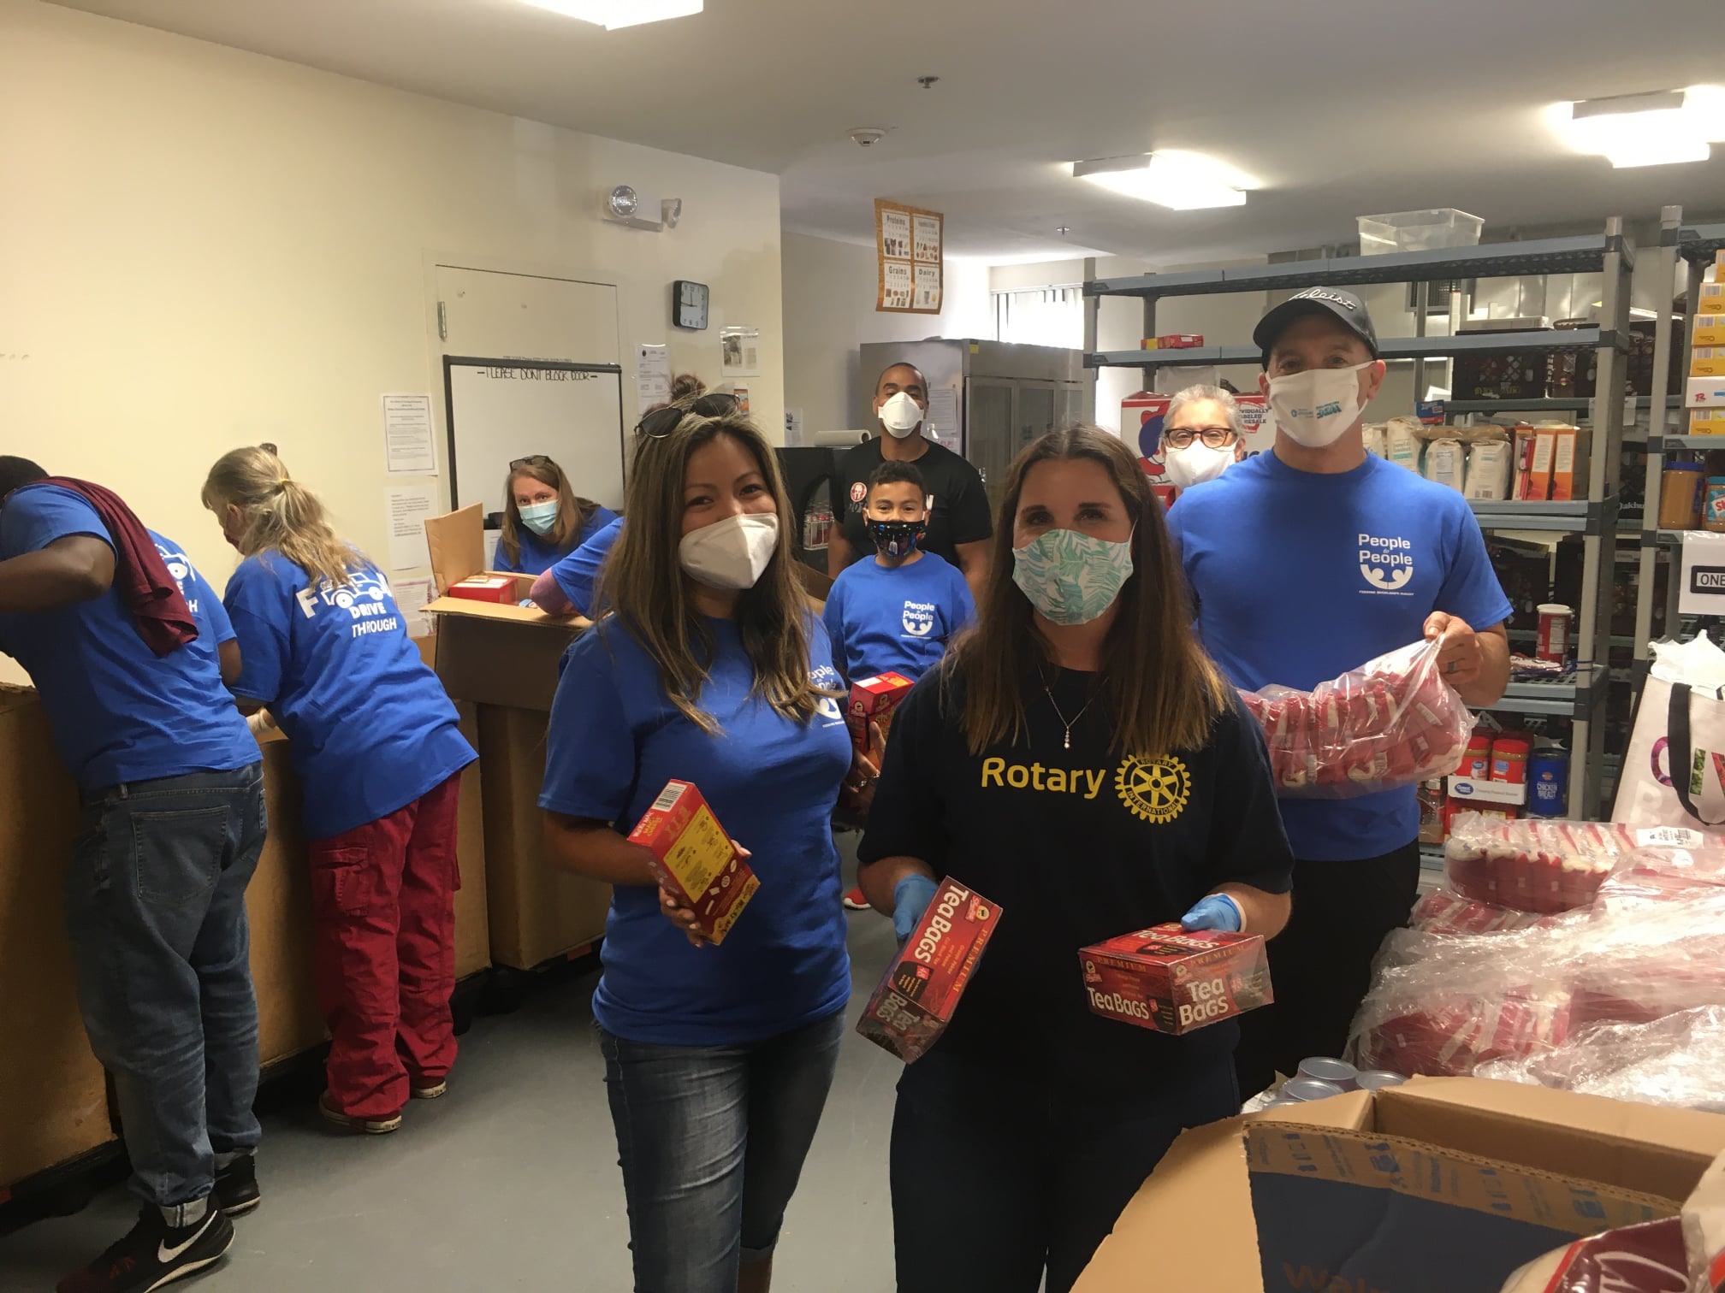
People to People Food Drive
Rotary Clubs in Rockland County held a food drive and collected over 50,000 pounds of food for People to People food bank.

Slide 25
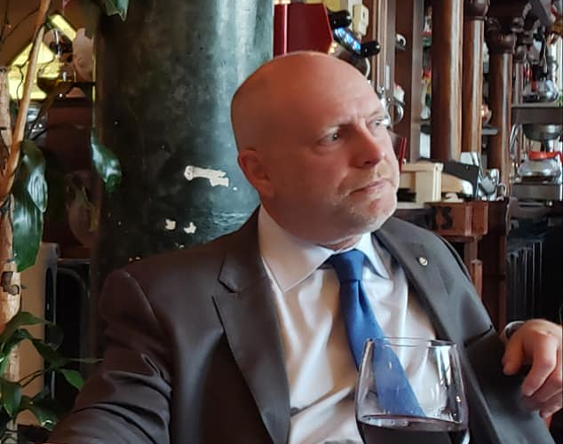
Meals on Wheels Director talks about Covid restrictions for future deliveries.
Rotarians, in teams of 2, deliver meals to seniors and those who can’t get out to access food for themselves.
Our Rotary Club delivers meals every Tuesday.

Slide 26
Nyack Rotary Membership Levels
2021 Full Membership Dues $275
Annual traditional membership
Monthly Meetings: 2 Lunch meetings
1 Happy Hour meeting
1 Cocktail for Charity

Slide 27
Nyack Rotary Membership Expectations
All members are expected to participate as their schedules allow in Nyack Rotary community events like Cover 2 Cover Literacy events at schools and community organizations, Valentine’s Day Baskets, raffle sales, social and fundraising events.

Slide 28
Nyack Rotary Club Yearly
Financial Commitments
Annual membership dues $275
Raffles Sales $250
Lunches on Tuesdays $20 per lunch
Happy Hours on Thursdays $10 for appetizers
Happy/Sad dollars for club $5 per meeting
Holiday senior food gift cards $40
Rotary Foundation $120
Holiday and Installation party $100

Slide 29
Membership Levels
2021 Corporate Membership Dues $600
Annual membership for 3 members of same organization
Networking opportunities include:
Monthly meetings for one person of the 3 members
2 lunch meetings
1 Happy Hour meeting
1 Cocktails for Charity
*note if members attend at the same time they pay additional fee
*each additional member of Corporate Membership is $200

Slide 30
Membership Levels
2021 Happy Hour Membership $240
Annual membership
Networking opportunities include: Monthly Meetings
1 Happy Hour Meeting
1 Cocktail for Charity Meeting
(2 optional lunch meetings)

Slide 31
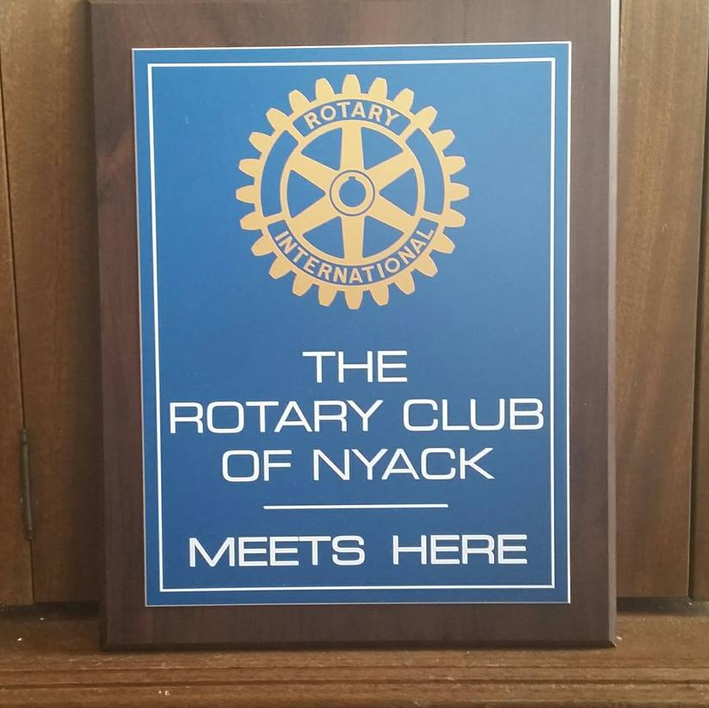
Nyack Rotary Welcomes those who share and demonstrate the principals of Service Above Self and the Four Way Test.

